Slide 1
ABC Clinic: Clinical Management System Software
COMP2147 - Systems Analysis, Design and Testing

Slide 2
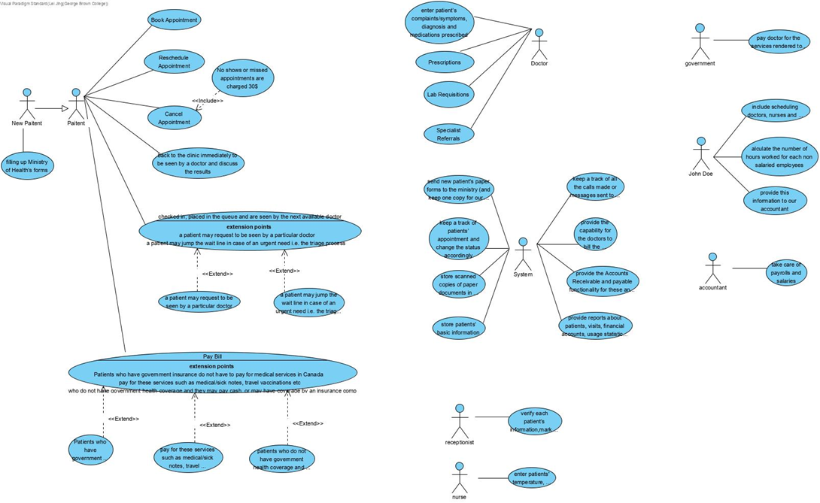
use case diagram

Slide 3
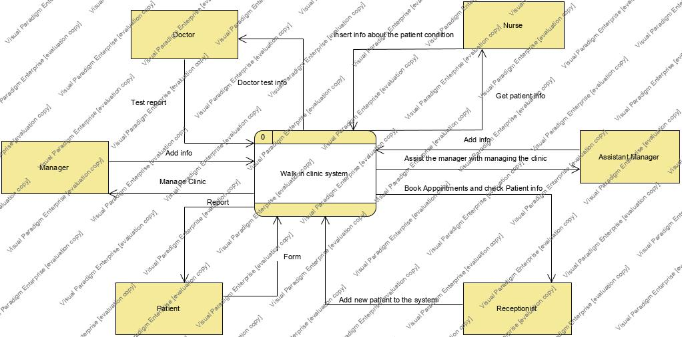
Level-0 DFD

Slide 4
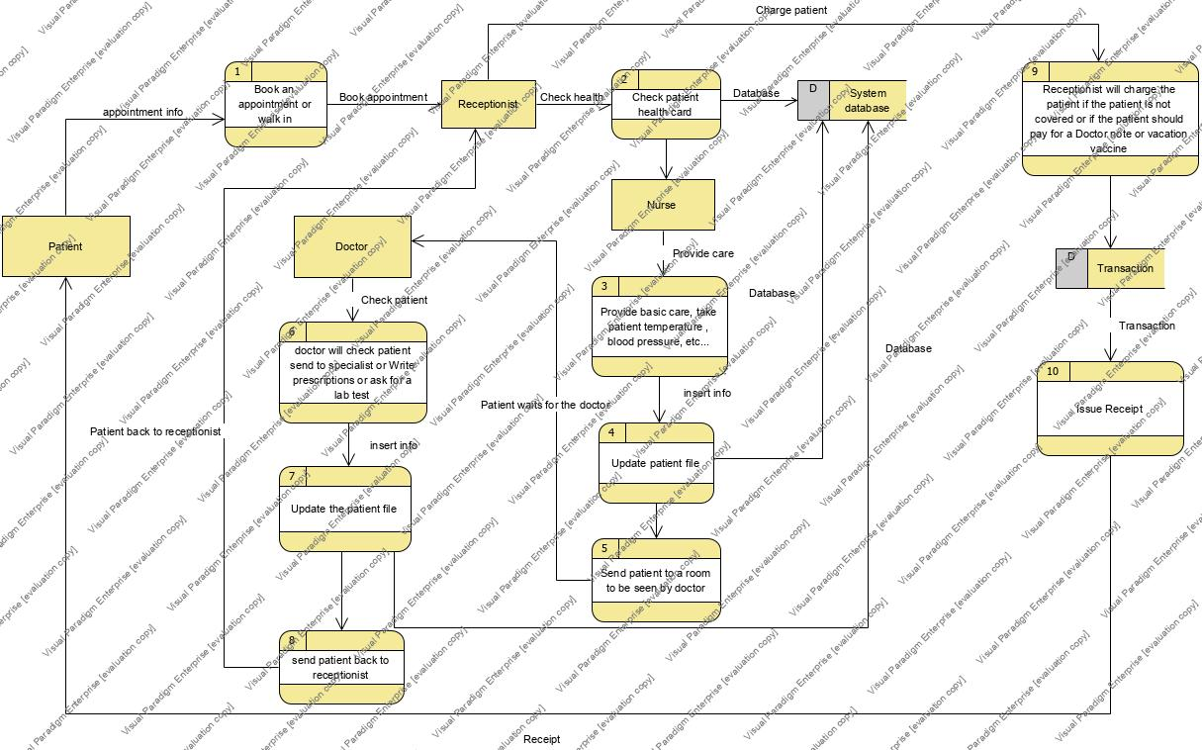

Slide 5
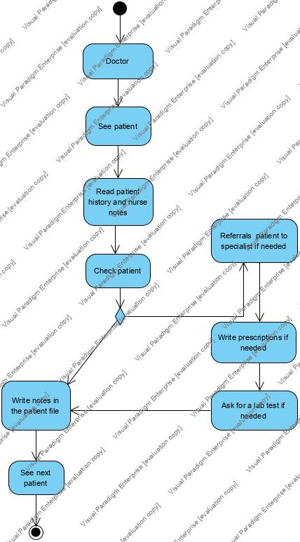
Activity Diagram 1

Slide 6
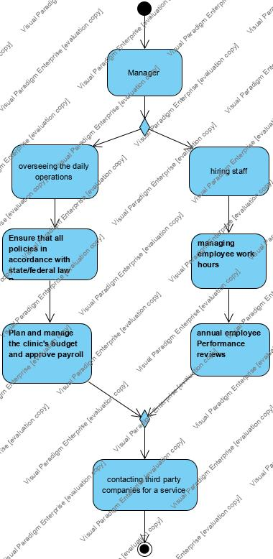
Activity Diagram 2

Slide 7
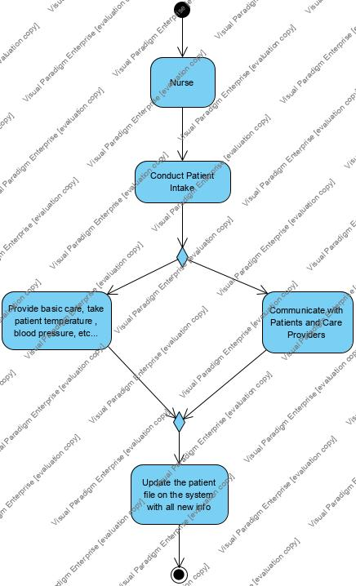
Activity Diagram 3

Slide 8
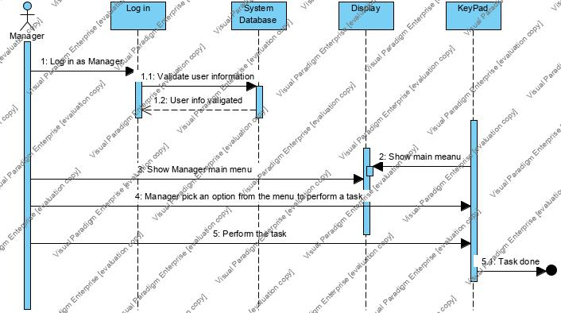
System Sequence Diagram 1

Slide 9
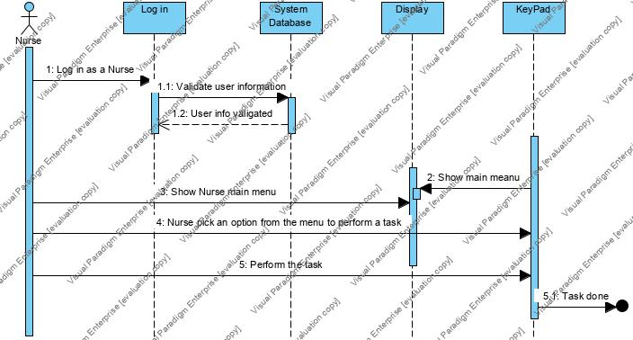
System Sequence Diagram 2

Slide 10
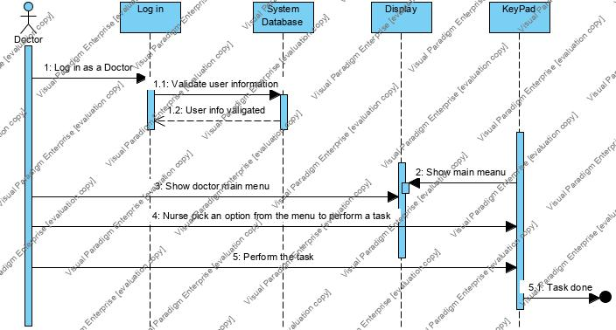
System Sequence Diagram 3

Slide 11
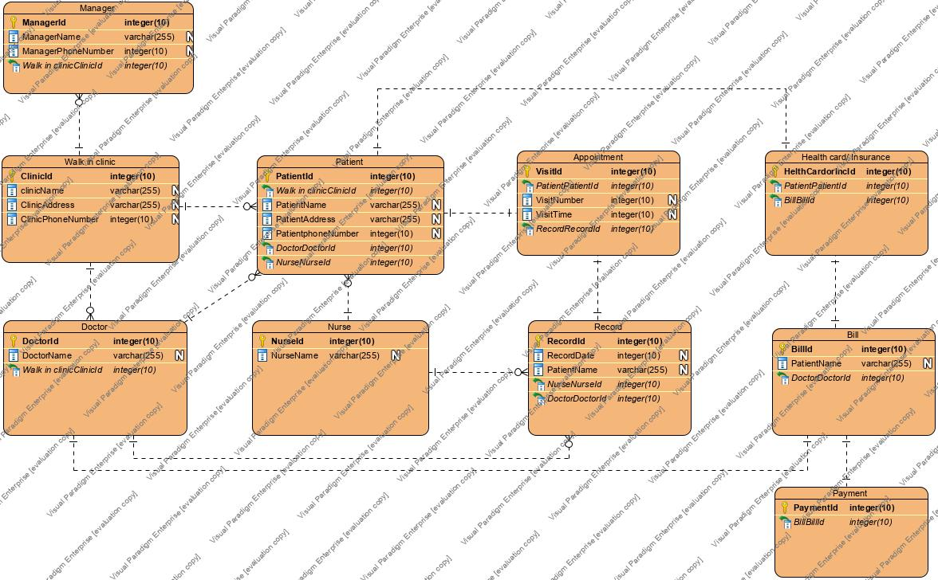
ER Model

Slide 12
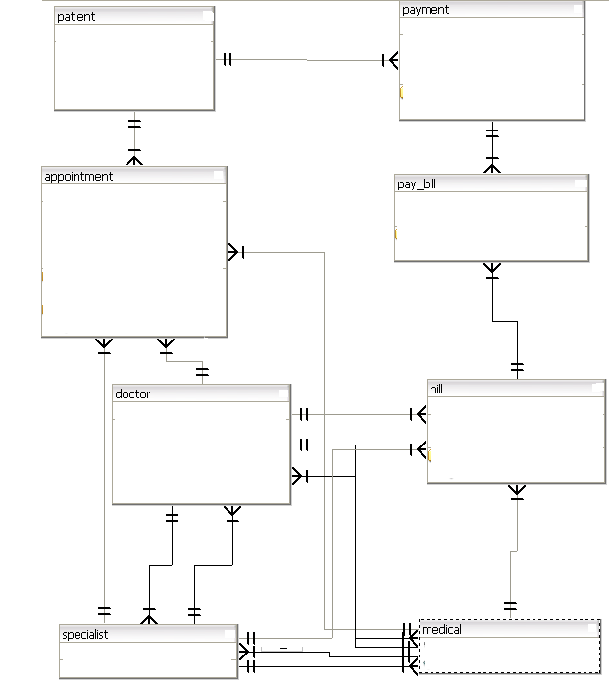
Additional ER Model

Slide 13
wireframe diagram 1

Slide 14
wireframe diagram 2

Slide 15
wireframe diagram 3

Slide 16
wireframe diagram 4

Slide 17
wireframe diagram 5

Slide 18
Group’s reflections/conclusion

